Slide 1
Research Title: Image Annotation
Group members Name and Id:
1. Md Sehabub Zaman Pranta - 1611251042
2. Tanvir Ahmed – 1410982042
3. Jannatul Ferdouse Onny - 1631561042
4. Sadia Ahmed Tandra – 1631474042
5. Rokeya Akanda Sriti - 1620165042

Slide 2
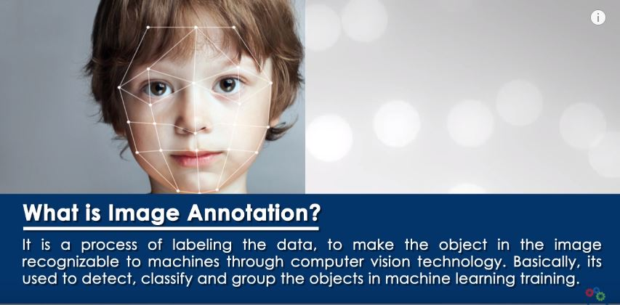
The Concept of Image Annotation

Slide 3
Different types of Image Annotation:
1. Bounding Box Annotation
2. 2D and 3D cuboid Annotation
3. Landmark Annotation
4. Video Annotation and so on.

Slide 4
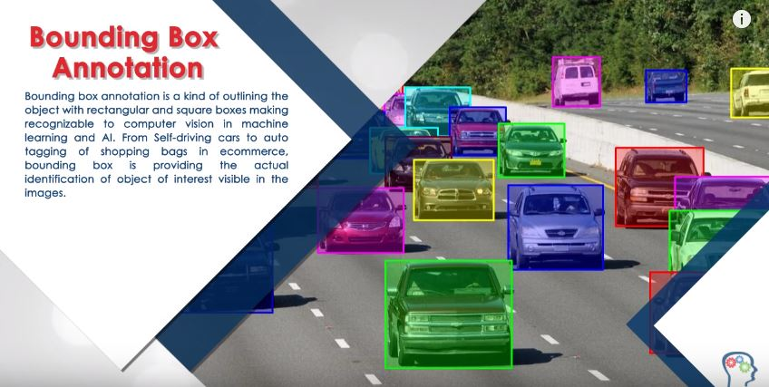
Types of Image Annotation

Slide 5
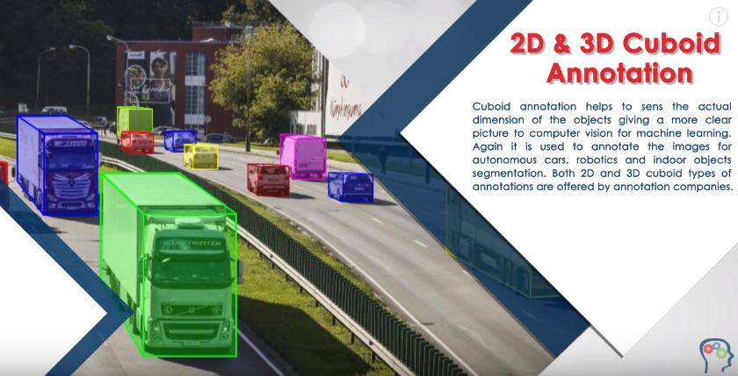
Types of Image Annotation

Slide 6
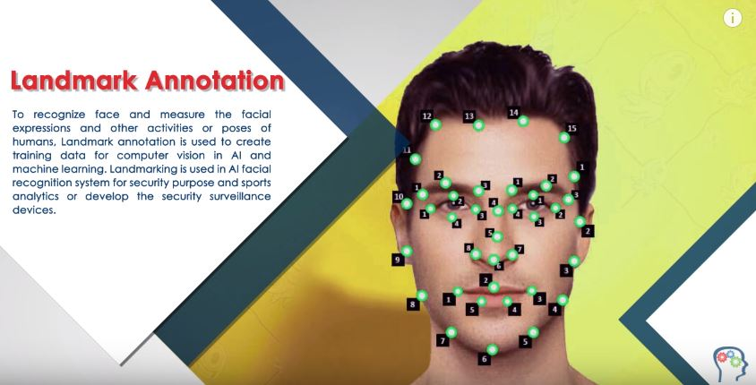
Types of Image Annotation

Slide 7
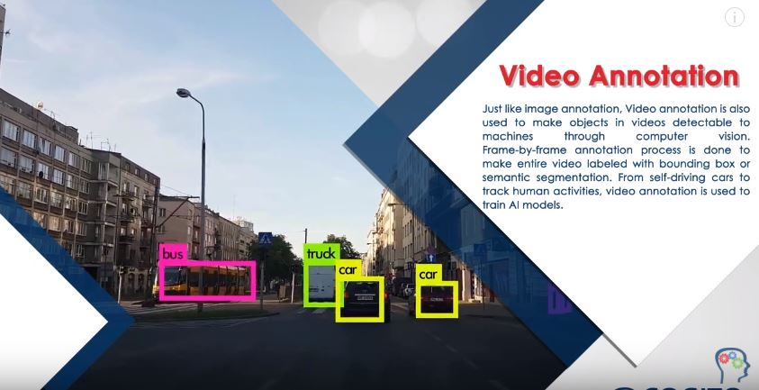
Types of Image Annotation

Slide 8
How to pick the right type of annotation?
Image annotation helps to make images readable for computer vision, computers use the annotated data to learn to recognize similar patterns when presented with new data. So, It all depends on the kind of use case we have.

Slide 9
Research Goal(Estimated):
Our goal is to work with a Road Image dataset where we will implement some Image Annotation model.
Our implemented model will describe(predict) the condition of a road from its training knowledge.

Slide 10
Library Required (Estimated):
TensorFlow: is an end-to-end open source platform for machine learning. It allows developers to create large-scale neural networks with many layers. is mainly used for: Classification, Perception, Understanding, Discovering, Prediction and Creation.
OpenCV: OpenCV is a library of programming functions mainly aimed at real-time computer vision. In simple language it is library used for Image Processing. It is mainly used to do all the operation related to Images.

Slide 11

Tools and Language(Estimated):
The Jupyter Notebook is an open source web application. This system supports over 100 programming languages including Python, Java, R, Julia, MATLAB, Octave, Scheme, Processing, Scala, and many more.
We will use python for programming.

Slide 12
The End! Thank You Everyone!

Slide 13
References: 1. https://medium.com/linkedai/introduction-to-image-annotation-for-computer-vision-652388b5532a 2. https://www.youtube.com/watch?v=FQOAkds5ws0 3. https://medium.com/computer-vision-technology-drives-the-future/top-11-tools-to-build-a-computer-vision-application-358b922849ee

